Slide 1
React Context API
What is Context API?
Prop Drilling.
Creating a Context
Providing Data
Consuming Context

Slide 2
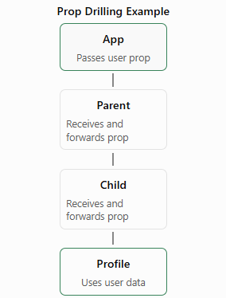
Context API
Context API is a built-in React feature used to share data between multiple components without passing props manually through every level.
Prop drilling is the process of passing data from a parent component to a deeply nested child component through multiple intermediate components, even when those intermediate components don't actually need the data.

Slide 3
Why Use Context API?
Eliminates unnecessary prop drilling.
Makes shared data accessible to multiple components.
Reduces repetitive prop passing.
Improves code organization.
Simplifies state sharing across component trees.
Suitable for small to medium global state requirements.

Slide 4
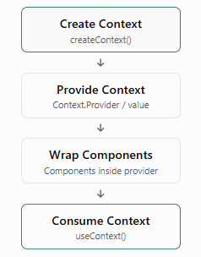
Important Concepts of Context API
createContext() : Creates a context object.
Provider : Supplies context data to child components.
useContext() : Allows functional components to consume context data.
Context value : The data or functions shared through the context.
Consumer : A component that reads data from the context.

Slide 5
1. Creating a Context
Import createContext from React.
Create a context using createContext().
Export the context so other components can access it.
A default value can be provided as a fallback when no matching provider exists.
Syntax
import { createContext } from "react";
export const UserContext = createContext(null);

Slide 6
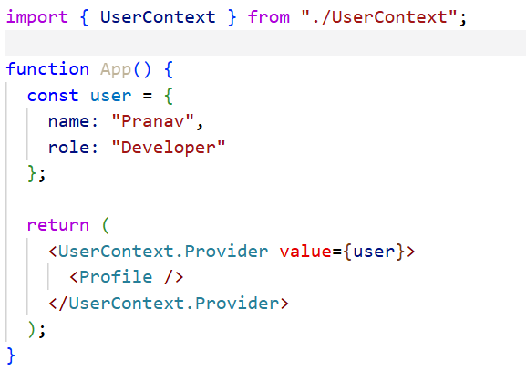
2. Providing Context Data
Use the context provider to make data available to child components.
Pass data using the value prop.
All descendant components within the provider can access the context.
The provider can supply values such as user details, themes, or authentication information.

Slide 7
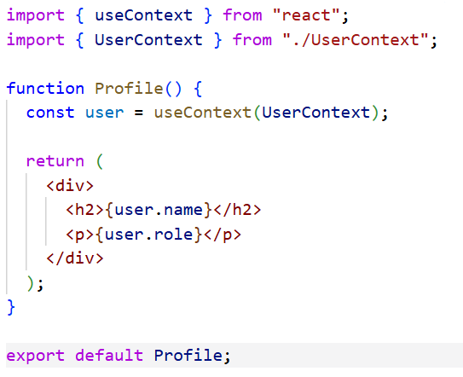
3. Consuming Context Using useContext()
useContext() is a React Hook.
It reads the current value of a context.
It eliminates the need to receive shared data through props.
When the context value changes, components using that context can re-render.

Slide 8
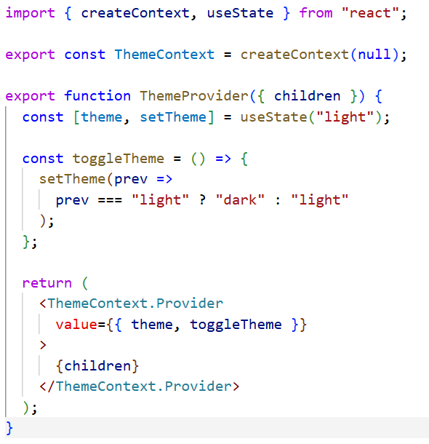
4. Context API with State
Context API can be combined with useState() to share dynamic data.
The provider manages the state.
Components can read the state and update it using shared functions.
Useful for shared values such as theme, login status, and shopping cart data.

Slide 9
Common Use Cases
Authentication : Share logged-in user information and authentication status.
Theme Management : Share light or dark theme settings.
Language Preferences : Share selected language throughout the application.
Shopping Cart : Share cart items and cart-related actions.
User Preferences : Share application settings and preferences.
Application Configuration : Share common configuration values.

